Slide 1
Block Ciphers
In general, a block cipher replaces a block of N plaintext bits with a block of N ciphertext bits. (E.g., N = 64 or 128.)
A block cipher is a monoalphabetic cipher.
Each block may be viewed as a huge character.
The “alphabet” consists of 2^{N} gigantic characters.
Each particular cipher is a one-to-one mapping from the plaintext “alphabet” to the ciphertext “alphabet”.
There are 2^{N}! such mappings.
A secret key indicates which mapping to use.

Slide 2
Ideal Block Cipher
A block cipher operates on a plaintext block of n bits to produce a ciphertext block of n bits.
There are 2^{n} possible different plaintext blocks and, for the encryption to be reversible (i.e., for decryption to be possible), each must produce a unique ciphertext block.
Such a transformation is called reversible, or nonsingular.
The following examples illustrate nonsingular and singular transformations for n = 2.
1

Slide 3
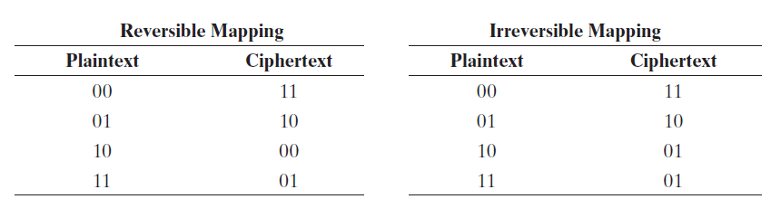
Ideal Block Cipher
In the latter case, a ciphertext of 01 could have been produced by one of two plaintext blocks. So if we limit ourselves to reversible mappings, the number of different transformations is 2^{n}!
The reasoning is as follows: For the first plaintext, we can choose any of 2^{n} ciphertext blocks. For the 2^{n}- 1 remaining ciphertext blocks, and so on.
1

Slide 4
Ideal Block Cipher
For a block cipher with block size n, there are 2^{n} possible plaintexts.
The number of possible keys (mappings) would then be 2^{n}!
An ideal block cipher would allow us to use any of these 2^{n}! mappings.
1

Slide 5
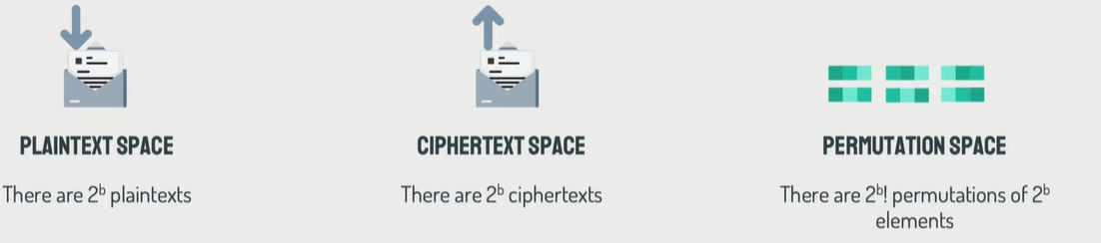
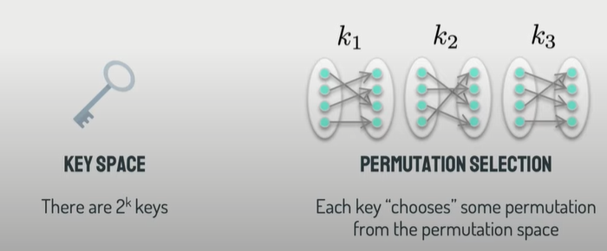
1

Slide 6
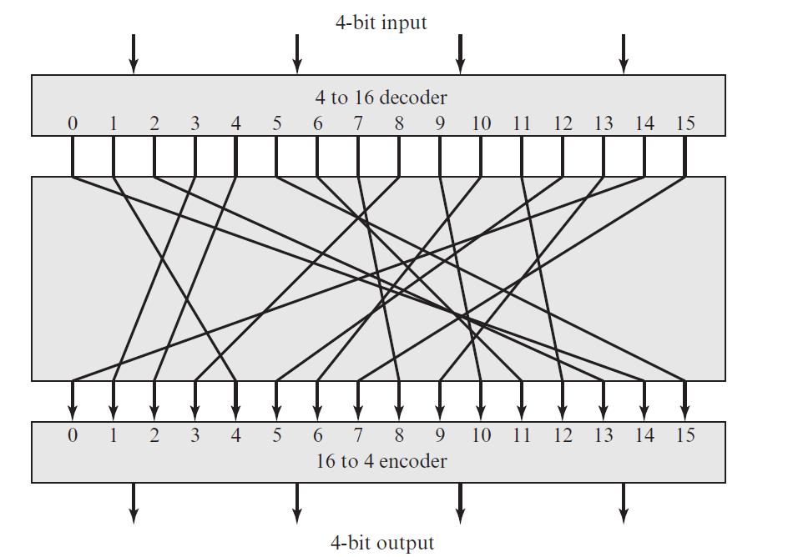
1

Slide 7
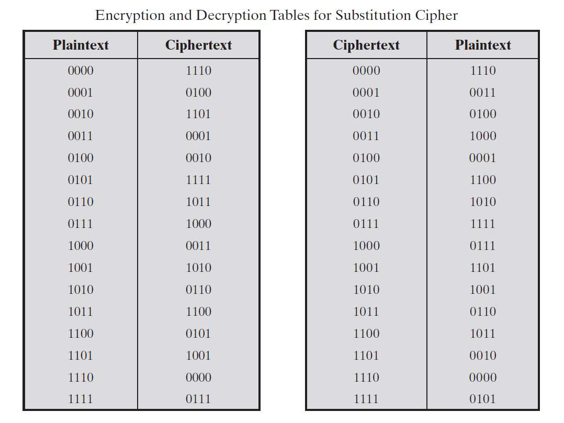
1

Slide 8
Ideal Block Cipher
The key size would be the required number of bits to express the number of possible permutations. So for 24 permutations, that would be a 5-bit key size.
This would require a key size of log₂(2^{N}!) bits =k.
If N = 64, k= log₂(2^{N}!) ≈ N x 2^{N} ≈ 10²¹ bits ≈ 10¹¹ GB.
Referring to the previous slide, the required key length is (4 bits) * (16 rows) = 64 bits.
In general, for an n-bit ideal block cipher, the length of the key defined in this fashion is n * 2^{n} bits. For a 64-bit block, which is a desirable length to prevent attacks, the required key length k is 64 * 2⁶⁴ bits.
The key space would be extremely large = 2^{k}.
Infeasible!

Slide 9
Practical Block Ciphers
N: Number of bits for plaintext and ciphertext
K: Number of bits for the key
2^{N:} Plaintext space
2^{K} : key space =2^{N}!
k= log₂(2^{N}!) ≈ N x 2^{N}
Modern block ciphers use a key of K bits to specify a random subset of 2^{K} mappings.
If K ≈ N,
  2^{K} is much smaller than 2^{N}!
  But is still very large.
If the selection of the 2^{K} mappings is random, the resulting cipher will be a good approximation of the ideal block cipher.
Horst Feistel, in1970s, proposed a method to achieve this.

Slide 10
The Feistel Cipher
Feistel proposed that we can approximate the ideal block cipher by utilizing the concept of a product cipher, which is the execution of two or more simple ciphers in sequence in such a way that the final result or product is cryptographically stronger than any of the component ciphers.
The essence of the approach is to develop a block cipher with a key length of k bits and a block length of n bits, allowing a total of 2^{k} possible transformations, rather than the 2^{n}! transformations available with the ideal block cipher.
Feistel proposed the use of a cipher that alternates substitutions and permutations
1

Slide 11
The Feistel Cipher Structure
Input: a data block and a key
Partition the data block into two halves L and R.
Go through a number of rounds.
In each round,
  R does not change.
  L goes through an operation that depends on R and a round key derived from the key.

Slide 12
Round i
L_{i-1} R_{i-1}
f
k_{i}
+
L_{i} R_{i}
Notes:
A substitution is performed on the left half of the data. This is done by applying a round function F to the right half of the data and then taking the exclusive-OR of the output of that function and the left half of the data.
Following this substitution, a permutation is performed that consists of the interchange of the two halves of the data.
Feistel block cipher operates on each block independently.
Generally, 16 rounds are performed in Feistel cipher.
Typical block size of Feistel cipher is 64-bit but modern block cipher uses 128-bit block.
Typical key size of Feistel cipher is 64-bit but modern block cipher has 128-bit key size.

Slide 13
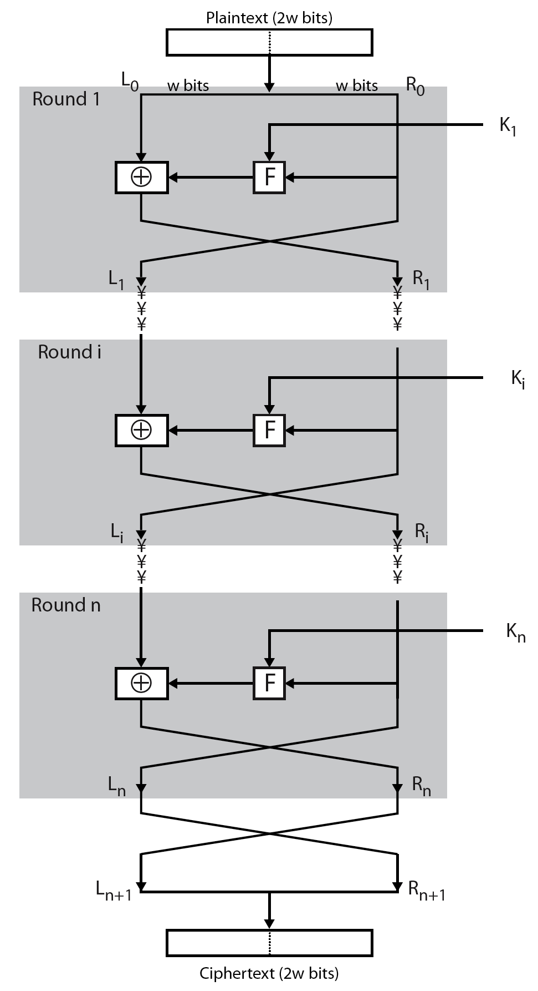


The Feistel Cipher Structure

Slide 14
The Feistel Cipher Structure
All rounds have the same structure:
A substitution is performed on the left half of the data. This is done by applying a round function F to the right half of the data and then taking the exclusive-OR of the output of that function and the left half of the data.
Following this substitution, a permutation is performed that consists of the interchange of the two halves of the data.
Feistel block cipher operates on each block independently.
Generally, 16 rounds are performed in Feistel cipher.
Typical block size of Feistel cipher is 64-bit but modern block cipher uses 128-bit block.
Typical key size of Feistel cipher is 64-bit but modern block cipher has 128-bit key size.

Slide 15
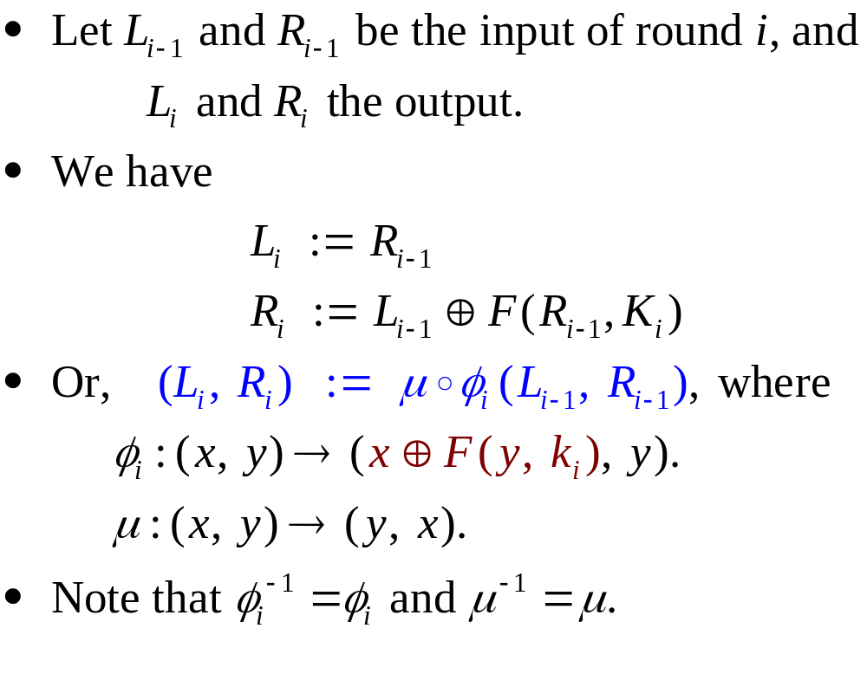
Mathematical Description of Round i

Slide 16
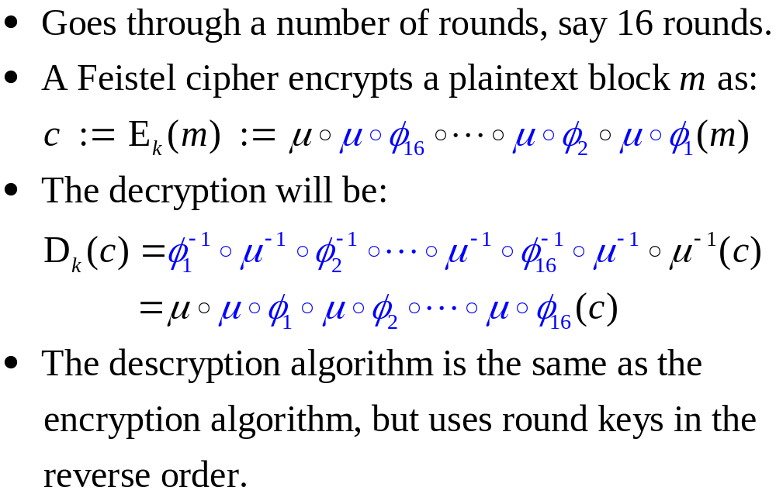
Feistel Cipher

Slide 17
DES: The Data Encryption Standard
Most widely used block cipher in the world.
Adopted by NIST in 1977.
Based on the Feistel cipher structure with 16 rounds of processing.
Block = 64 bits
Key = 56 bits
What is specific to DES is the design of the F function and how round keys are derived from the main key.

Slide 18
Design Principles of DES
To achieve high degree of diffusion and confusion.
Diffusion: making each plaintext bit affect as many ciphertext bits as possible (permutation).
Confusion: making the relationship between the encryption key and the ciphertext as complex as possible (substitution).
1

Slide 19
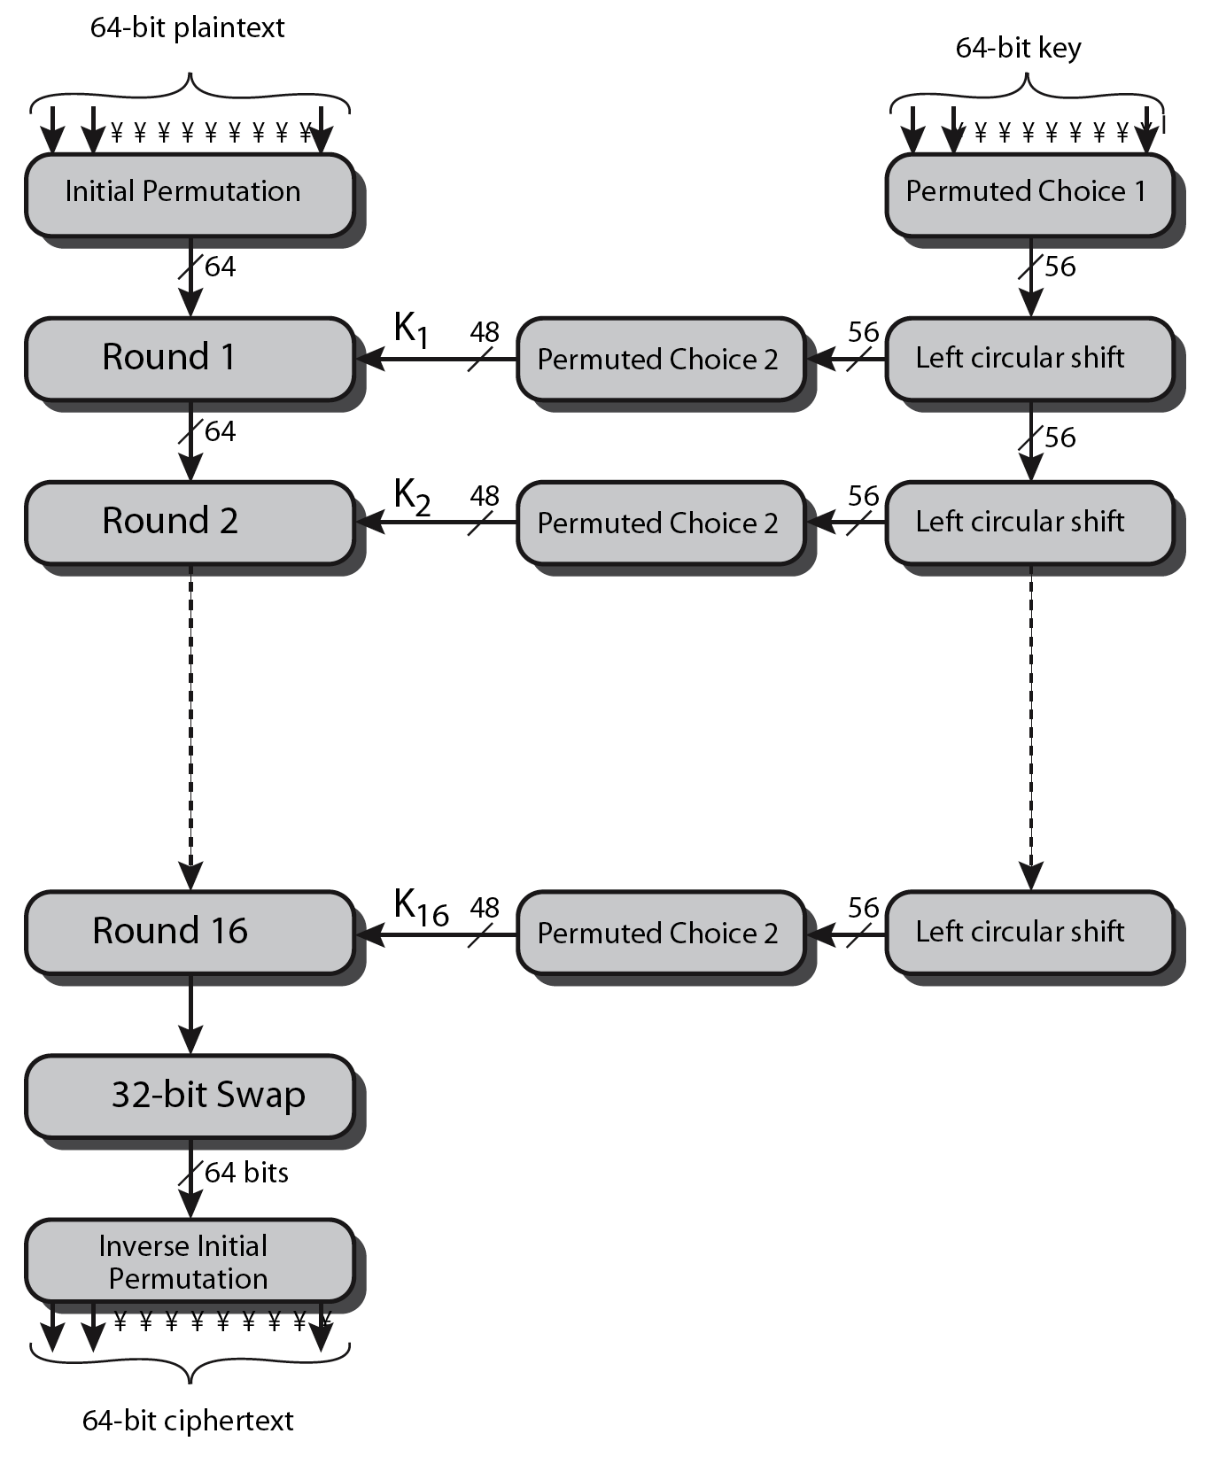
DES Encryption Overview

Slide 20
Round Keys Generation
Main key: 64 bits.
56-bits are selected and permuted using Permuted Choice One (PC1); and then divided into two 28-bit halves.
In each round:
  Left-rotate each half separately by either 1 or 2 bits according to a rotation schedule.
  Select 24-bits from each half, and permute the combined 48 bits.
  This forms a round key.
Notes:
The 56 bit key size comes from security considerations as we know now. It was big enough so that an exhaustive key search was about as hard as the best direct attack (a form of differential cryptanalysis called a T-attack, known by the IBM & NSA researchers), but no bigger. The extra 8 bits were then used as parity (error detecting) bits, which makes sense given the original design use for hardware communications links. However we hit an incompatibility with simple s/w implementations since the top bit in each byte is 0 (since ASCII only uses 7 bits), but the DES key schedule throws away the bottom bit! A good implementation needs to be cleverer!

Slide 21
Permuted Choice One (PC1)
57 | 49 | 41 | 33 | 25 | 17 | 9
1 | 58 | 50 | 42 | 34 | 26 | 18
10 | 2 | 59 | 51 | 43 | 35 | 27
19 | 11 | 3 | 60 | 52 | 44 | 36
63 | 55 | 47 | 39 | 31 | 23 | 15
7 | 62 | 54 | 46 | 38 | 30 | 22
14 | 6 | 61 | 53 | 45 | 37 | 29
21 | 13 | 5 | 28 | 20 | 12 | 4

Slide 22
Initial Permutation IP
IP: the first step of the encryption.
It reorders the input data bits.
The last step of encryption is the inverse of IP.
IP and IP⁻¹ are specified by tables (see Stallings book, Table 3.2) or http://en.wikipedia.org/wiki/DES_supplementary_material

Slide 23
Round i
L_{i-1} R_{i-1}
32
F
k_{i}
48
32
32
+
L_{i} R_{i}

Slide 24
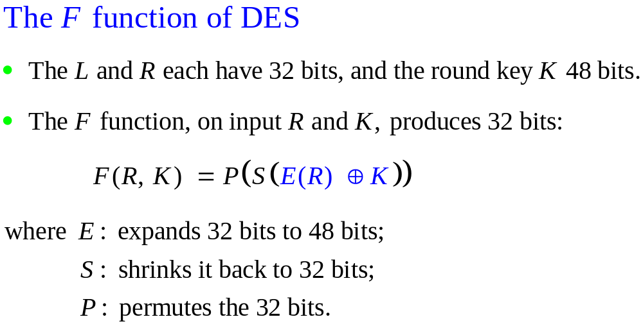

Slide 25

The F function of DES

Slide 26
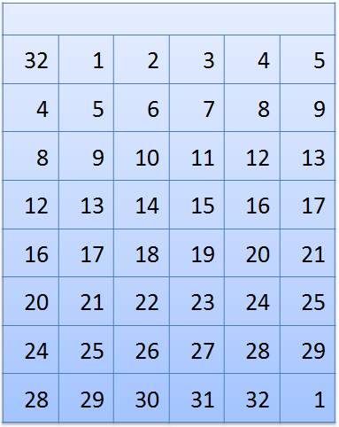
The Expansion Permutation E

Slide 27
The S-Boxes
Eight S-boxes each map 6 to 4 bits
Each S-box is specified as a 4 x 16 table
  each row is a permutation of 0-15
  outer bits 1 & 6 of input are used to select one of the four rows
  inner 4 bits of input are used to select a column
All the eight boxes are different.
Notes:
The example lists 8 6-bit values (ie 18 in hex is 011000 in binary, 09 hex is 001001 binary, 12 hex is 010010 binary, 3d hex is 111101 binary etc), each of which is replaced following the process detailed above using the appropriate S-box. ie
S1(011000) lookup row 00 col 1100 in S1 to get 5
S2(001001) lookup row 01 col 0100 in S2 to get 15 = f in hex
S3(010010) lookup row 00 col 1001 in S3 to get 13 = d in hex
S4(111101) lookup row 11 col 1110 in S4 to get 2 etc

Slide 28
Box S₁
0 1 2 3 4 5 6 7 8 9 10 11 12 13 14 15
14 | 4 | 13 | 1 | 2 | 15 | 11 | 8 | 3 | 10 | 6 | 12 | 5 | 9 | 0 | 7
0 | 15 | 7 | 4 | 14 | 2 | 13 | 1 | 10 | 6 | 12 | 11 | 6 | 5 | 3 | 8
4 | 1 | 14 | 8 | 13 | 6 | 2 | 11 | 15 | 12 | 9 | 7 | 3 | 10 | 5 | 0
15 | 12 | 8 | 2 | 4 | 9 | 1 | 7 | 5 | 11 | 3 | 14 | 10 | 0 | 6 | 13
0
1
2
3
For example, S₁(101010) = 6 = 0110.

Slide 29
Permutation Function P
P
16 | 7 | 20 | 21
29 | 12 | 28 | 17
1 | 15 | 23 | 26
5 | 18 | 31 | 10
2 | 8 | 24 | 14
32 | 27 | 3 | 9
19 | 13 | 30 | 6
22 | 11 | 4 | 25
1

Slide 30
Avalanche Effect
Avalanche effect:
  A small change in the plaintext or in the key results in a significant change in the ciphertext.
  an evidence of high degree of diffusion (permutation) and confusion (substitution)
  a desirable property of any encryption algorithm
DES exhibits a strong avalanche effect
  Changing 1 bit in the plaintext affects 34 bits in the ciphertext on average.
  1-bit change in the key affects 35 bits in the ciphertext on average.

Slide 31
The rest of slides are self reading☺☺
1

Slide 32
Attacks on DES
Brute-force key search
  Needs only two plaintext-ciphertext samples
  Trying 1 key per microsecond would take 1000+ years on average, due to the large key space size, 2⁵⁶ ≈ 7.2×10¹⁶.
Differential cryptanalysis
  Possible to find a key with 2⁴⁷ plaintext-ciphertext samples
  It involve a precise analysis of how differences in information input can influence the resulting characteristics at the output.
  Known-plaintext attack
Linear cryptanalysis:
  Possible to find a key with 2⁴³ plaintext-ciphertext samples
  in which the attacker studies probabilistic linear relations called a linear approximations among parity bits of the plaintext, the Ciphertext and the hidden key.
  Known-plaintext attack

Slide 33
DES Cracker
DES Cracker:
  A DES key search machine
  contains 1536 chips
  Cost: $250,000.
  could search 88 billion keys per second
  won RSA Laboratory’s “DES Challenge II-2” by successfully finding a DES key in 56 hours.
DES is feeling its age. A more secure cipher is needed.

Slide 34
Multiple Encryption with DES
In 2001, NIST published the Advanced Encryption Standard (AES) to replace DES.
But users in commerce and finance are not ready to give up on DES.
As a temporary solution to DES’s security problem, one may encrypt a message (with DES) multiple times using multiple keys:
  2DES is not much securer than the regular DES
  So, 3DES with either 2 or 3 keys is used

Slide 35
2DES
Consider 2DES with two keys:
  C = E_{K2}(E_{K1}(P))
Decryption: P = D_{K1}(D_{K2}(C))
Key length: 56 x 2 = 112 bits
This should have thwarted brute-force attacks?
Wrong!

Slide 36
Meet-in-the-Middle Attack on 2DES
Given a known pair (P, C) the attack proceeds as follows:
1) Encrypt P for all 2⁵⁶ possible values of K1
2) Store these results in a table and then sort the table by the values of X.
3) Next, decrypt C using all the 2⁵⁶ possible values of K2.
As each decryption is produced check the result against the table for a match.
4) If a match occurs, then test the 2 resulting keys against a new known plain text – cipher text pair.
If the 2 keys produce the correct cipher text, accept them as the correct keys.
1

Slide 37
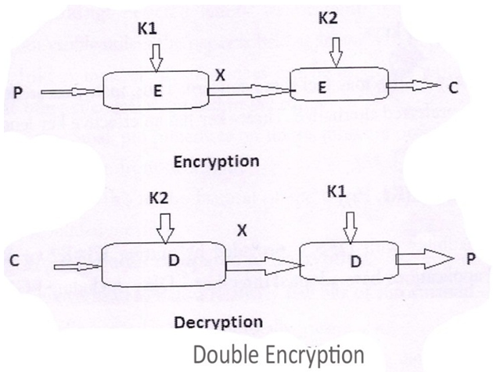
Meet-in-the-Middle Attack on 2DES
1

Slide 38
Meet-in-the-Middle Attack on 2DES
2-DES: C = E_{K2}(E_{K1}(P))
Given a known pair (P, C), attack as follows:
  Encrypt P with all 2⁵⁶ possible keys for K1.
  Decrypt C with all 2⁵⁶ possible keys for K2.
  If E_{K1’}(P) = D_{K2’}(C), try the keys on another (P’, C’).
  If works, (K1’, K2’) = (K1, K2) with high probability.
  Takes O(2⁵⁶) steps; not much more than attacking 1-DES.
E_{K1}
E_{K2}
P C

Slide 39
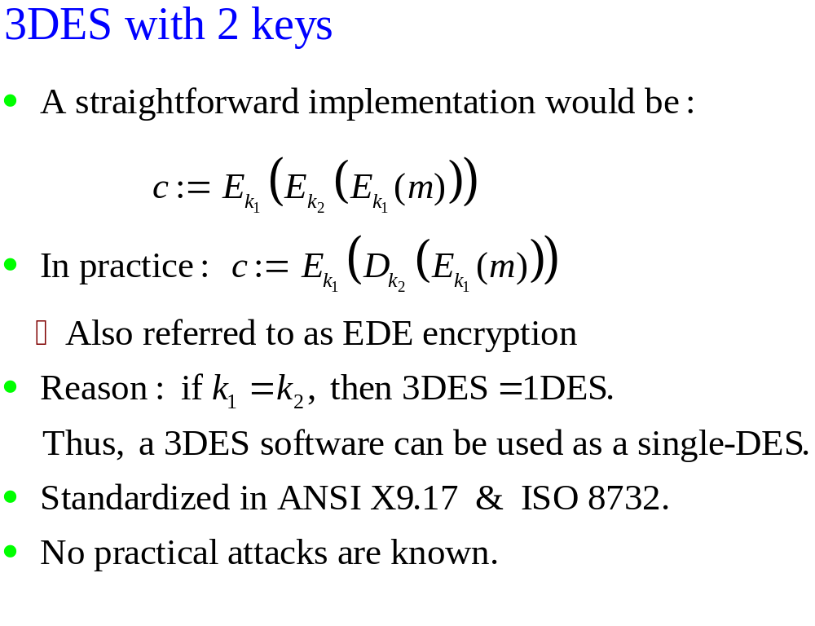
In each case the middle operation is the reverse of the first and last. This improves the strength of the algorithm.

Slide 40
